Slide 1

Calling Methods
You use an object by calling its methods.
All objects of a given class share a common set of methods.
The PrintStream class provides methods for its objects such as:
println
print

Slide 2
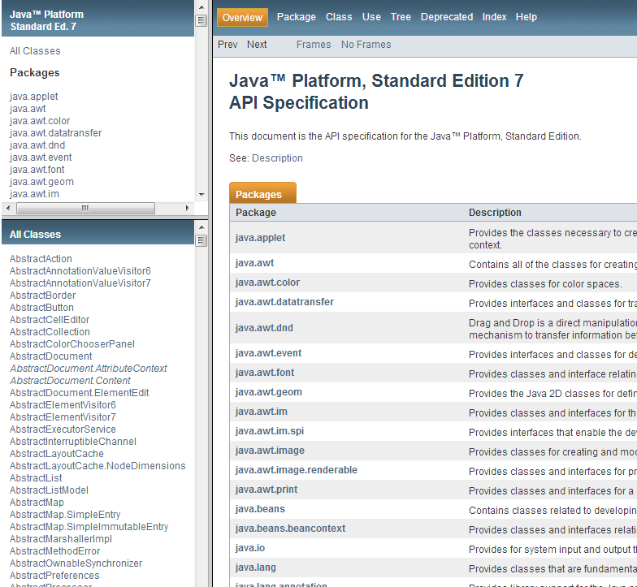
Explore this link
http://docs.oracle.com/javase/8/docs/api/

Slide 3
Calling Methods
The String class provides methods that you can apply to all String objects.
Example: length
String greeting = “Hello, World!”;
int numberOfCharacters = greeting.length();
//numberOfCharacters now contains 13
Example: toUpperCase
String river = “Mississippi”;
String bigRiver = river.toUpperCase();
//bigRiver now contains MISSISSIPPI

Slide 4
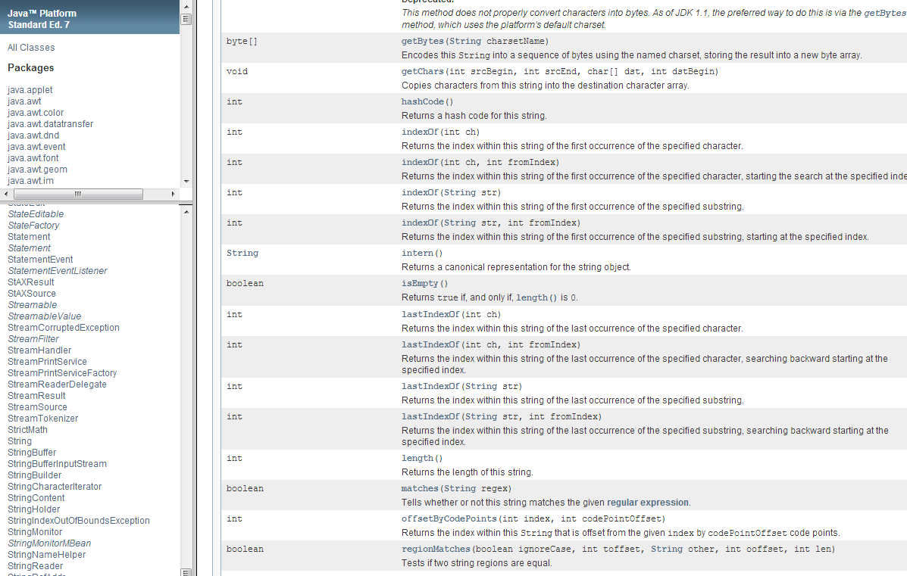
Try to find the length method in the String class

Slide 5
The Public Interface of a Class
The String class declares many other methods besides the length and toUpperCase methods.
Collectively, the methods form the public interface of the class.
The public interface of a class specifies what you can do with its objects.

Slide 6
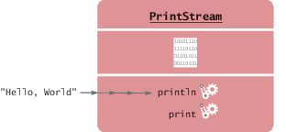
Method Arguments
Most methods require values that give details about the work that the method needs to do.
You must supply the string that should be printed when you call the println method.
The technical term for method inputs: arguments.
The string greeting is an argument of this method call:
System.out.println(greeting);
Figure 6 Passing an Argument to the println Method

Slide 7
Method Arguments
Some methods require multiple arguments.
Other methods don't require any arguments at all.
Example: the length method of the String class
All the information that the length method requires to do its job is stored in the object
int numberOfCharacters = greeting.length();

Slide 8
Return Values
Some methods carry out an action for you.
Example: println method
Other methods compute and return a value.
Example: the String length method
returns a value: the number of characters in the string.
You can store the return value in a variable:
int numberOfCharacters = greeting.length()
The return value of a method is a result that the method has computed.

Slide 9
Return Values
You can also use the return value of one method as an argument of another method:
System.out.println(greeting.length());
The method call greeting.length() returns a value - the integer 13.
The return value becomes an argument of the println method.

Slide 10
Return Values – replace Method
Example: assume String river = "Mississippi";
Then the statement
river = river.replace("issipp", "our");
Constructs a new String by
Replacing all occurrences of "issipp" in "Mississippi" with "our"
Returns the constructed String object "Missouri"
And saves the return value in the same variable
You could pass the return value to another method:
System.out.println(river.replace("issipp", "our"));

Slide 11
Upload to BB
If you heard no message in my narration the correct message to upload to BB is:
“2.3 was interesting!”

Slide 12
Self Check 2.13
How can you compute the length of the string "Mississippi"?
Answer:
river.length()

Slide 13
Self Check 2.14
How can you print out the uppercase version of
"Hello, World!“ stored in the greeting variable?
Answer:
System.out.println(greeting.toUpperCase());

Slide 14
Self Check 2.15
Is it legal to call river.println()? Why or why not?
Answer:
It is not legal.
The variable river has type String. The println method is not a method of the String class.

Slide 15
Self Check 2.16
What are the arguments in the method call
river.replace("p", "s")?
Answer:
The arguments are the strings "p" and "s".

Slide 16
Self Check 2.17
What is the returned by the call river.replace("p", "s”), where river is "Mississippi"?
Answer:
"Missississi"

Slide 17
Self Check 2.19
How is the toUpperCase method declared in the String class?
Answer: As public String toUpperCase(), with no argument and return type String.

